Slide 1

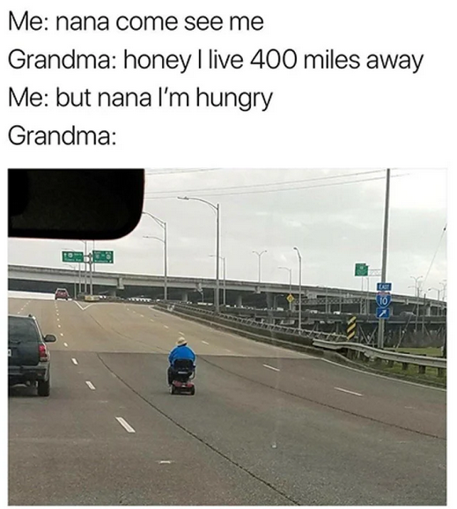
Oral Presentation
How wholesome memes could save us all
Written by Annalee Newitz

Slide 2
Summary
With the pandemic of Covid 19, people are spending more time on the web, in order to avoid problems of the real world. Video games and “wholesome memes” distract us from death and politics. But it can end with “toxic positivity”. However, the web is a lot more than just wholesome memes. Michael Hauben coined in the mid 90s the term “netizen”, to describe people who were involved in early forums and group chats. The notion evolved since, with researchers using it to talk about digital activism. The term needs to be thought over again, considering the growth of online communities, some of which are even bigger than countries. These communities exist however on social networks and platforms owned by big companies which are now wealthier and as powerful as many nations thanks to content users put into them. These companies owe us more than just escapism, they owe us rights and protection.

Slide 3

Wholesomeness of the Web
Video games

Slide 4

Wholesomeness of the Web
Video games
Wholesome memes

Slide 5


Toxic positivity
Video games
Wholesome memes

Slide 6
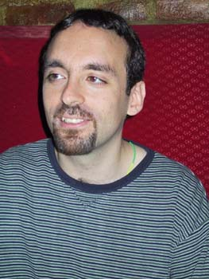
Netizen
Michael Hauben

Slide 7


Netizen
Michael Hauben
Early forums
Chat groups

Slide 8


Netizen 2,0
Zeynep Tufekci & Molly Sauter

Slide 9
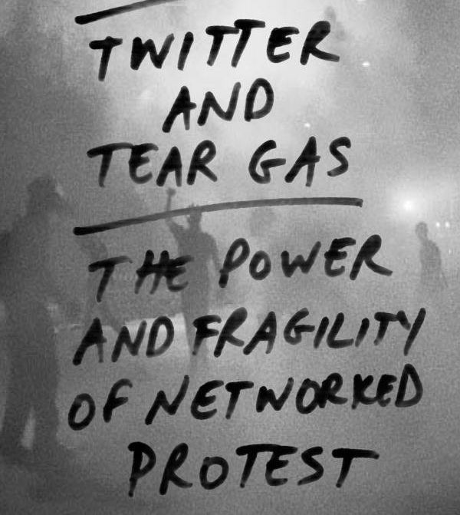
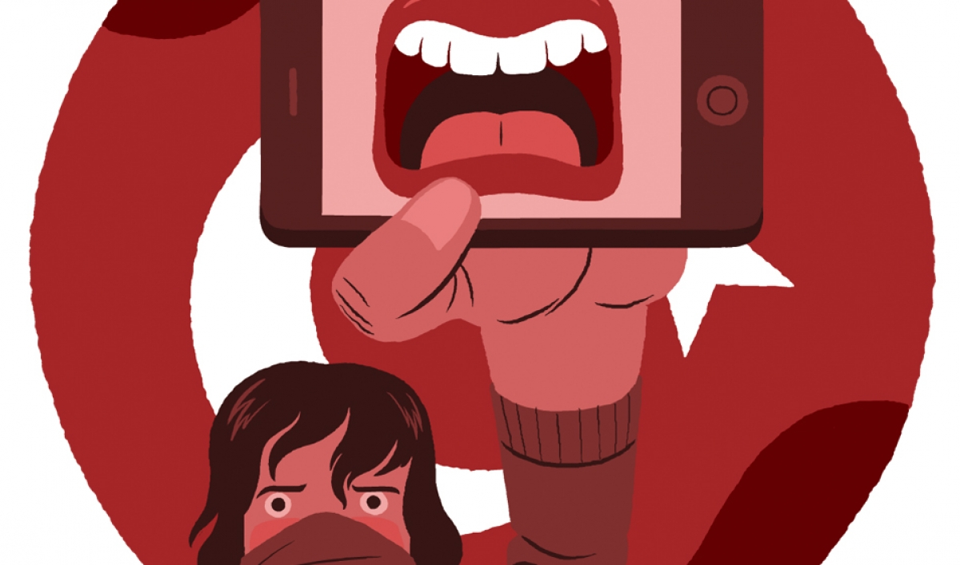
Netizen 2,0
Zeynep Tufekci & Molly Sauter
Networked protests
Digital activism

Slide 10
Netizen 3,0?

Slide 11



Netizen 3,0?
International communities

Slide 12

Netizen 3,0?
International communities

Slide 13
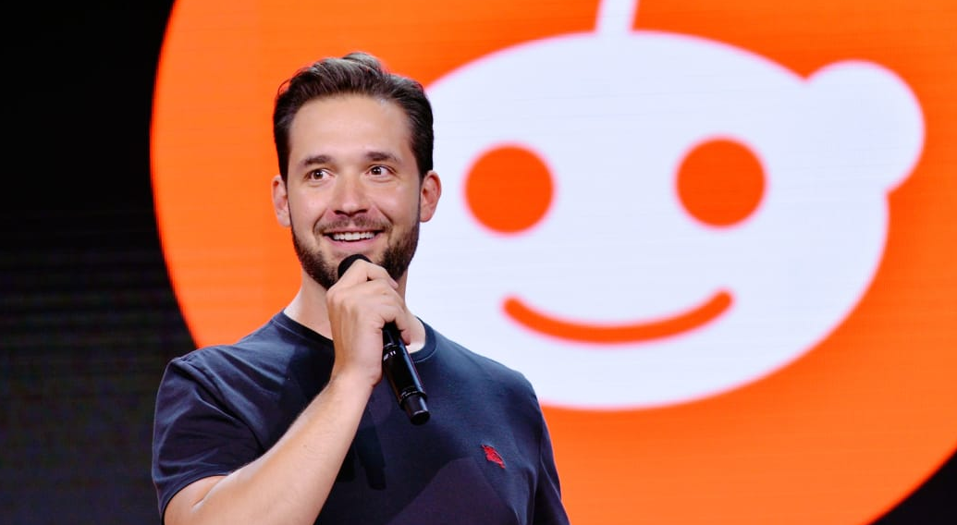
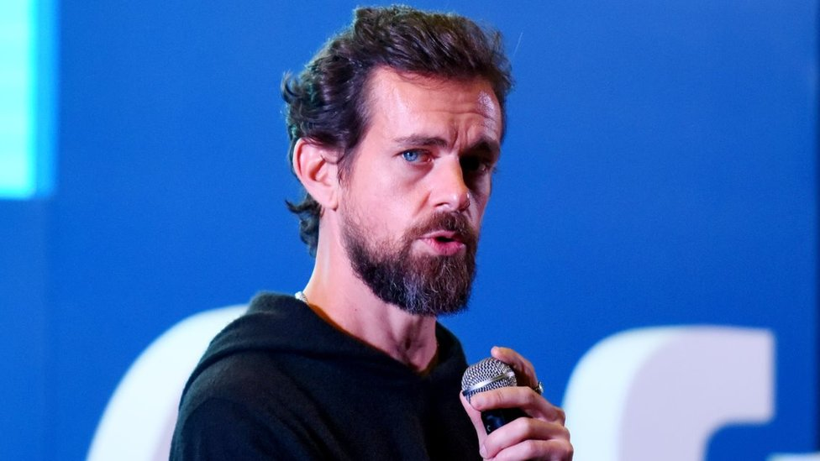
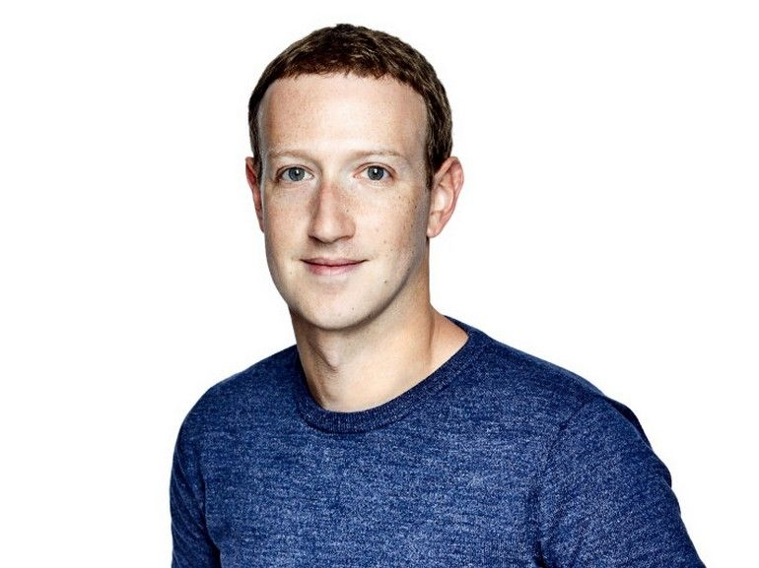
Netizen 3,0?
Big Companies

Slide 14
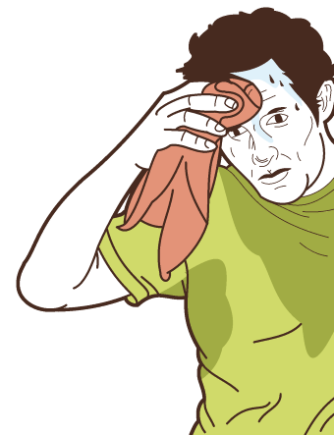
Netizen 3,0?
Big Companies

Slide 15
Netizen 3,0
Rights and protection

Slide 16
Netizen 3,0
Rights and protection
Came for the cute bunnies, but stayed for the growing body politics

Slide 17
My opinion
Too much divergence on social media
Not as much power as the author sugests

